Slide 1
Hollydale Elementary Data Overview
Presentation by Maggie Phillips
Tuesday, April 16, 2013

Slide 2
Purpose
The purpose of this Data Overview is to use data to draw attention to and start conversations related to student achievement at Hollydale Elementary. By isolating trends, identify areas of strength and areas that need to be strengthened, we can begin conversations to help us improve overall student learning.

Slide 3
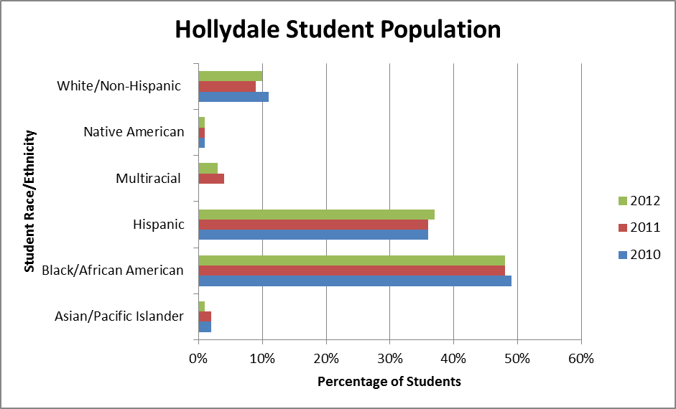
School Demographics
2010 Enrollment 763 | 2011 Enrollment 735 | 2012 Enrollment 608

Slide 4
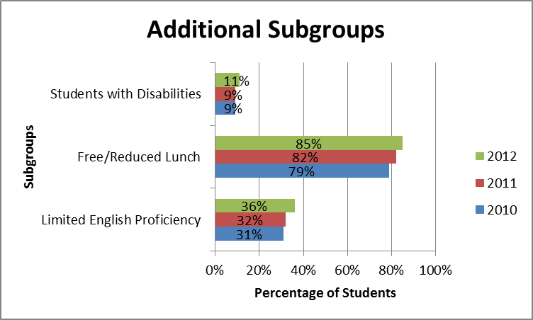
School Demographics

Slide 5
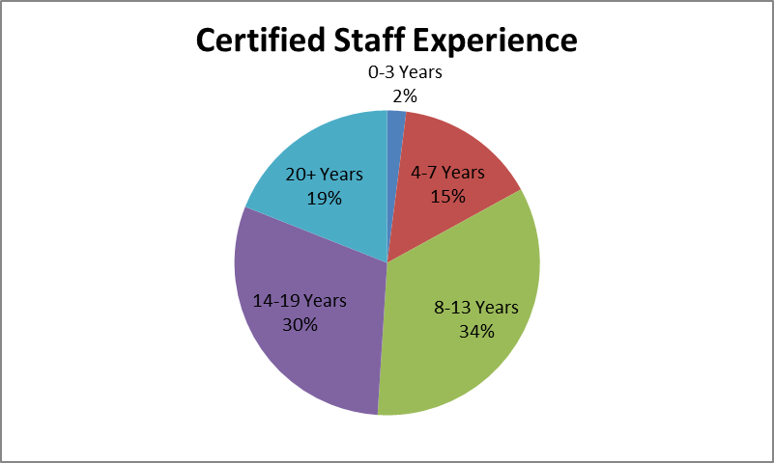
Staff Information
N = 59

Slide 6
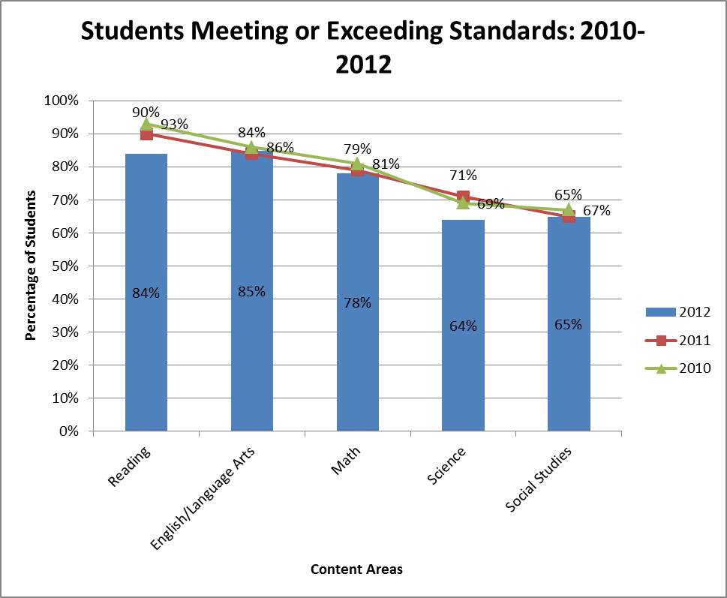
Hollydale Data
2010 N = 381
2011 N = 367
2012 N = 304

Slide 7
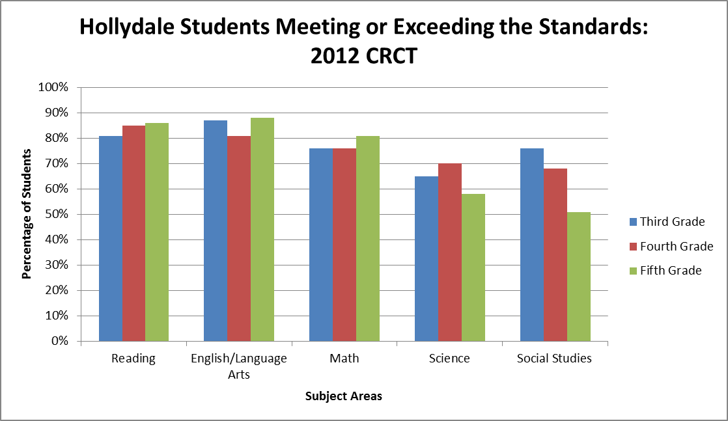
Hollydale Data

Slide 8
Discussion
Why do you think the number of students meeting or exceeding the standards in Science and Social Studies is significantly lower than in the other content areas?

Slide 9
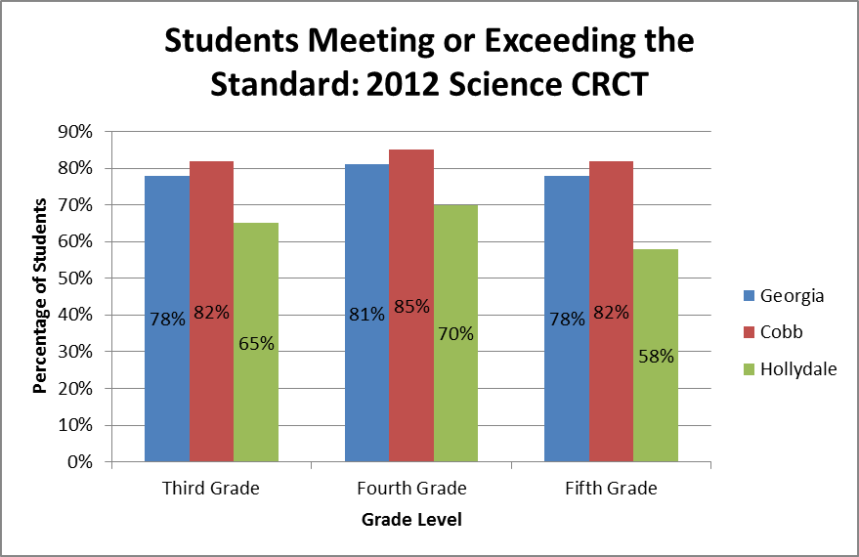
2012 Comparison Data: Science

Slide 10
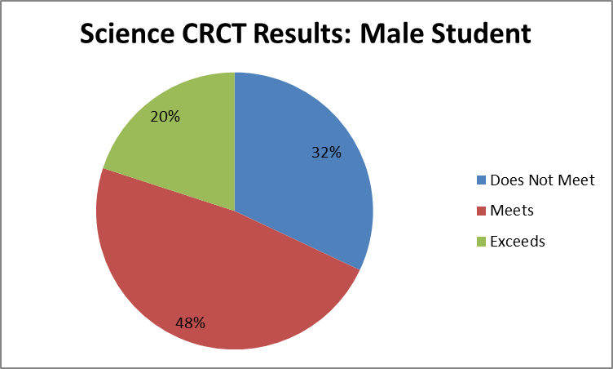
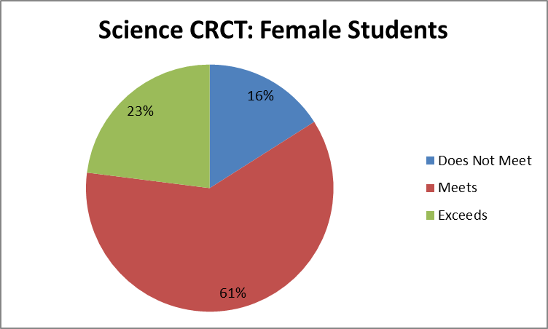
Looking Closer: Science
68% of male students met or exceeded Science Standards
84% of female students met or exceeded Science Standards
Data from Spring 2012

Slide 11
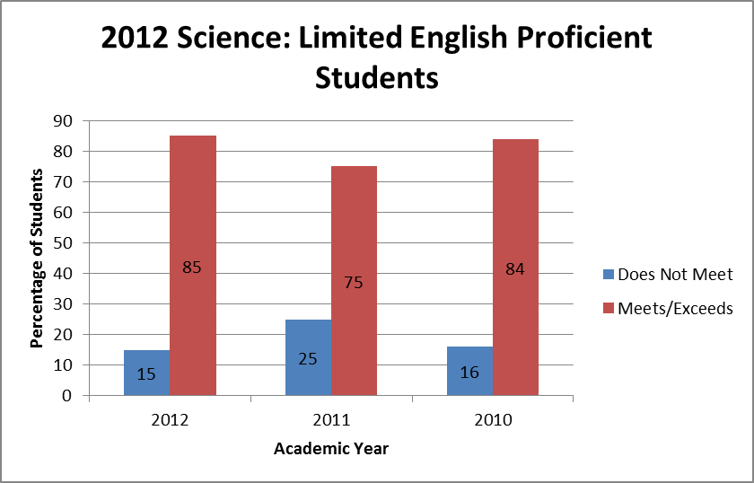
Looking Closer: 2012 Science Limited English Proficiency

Slide 12
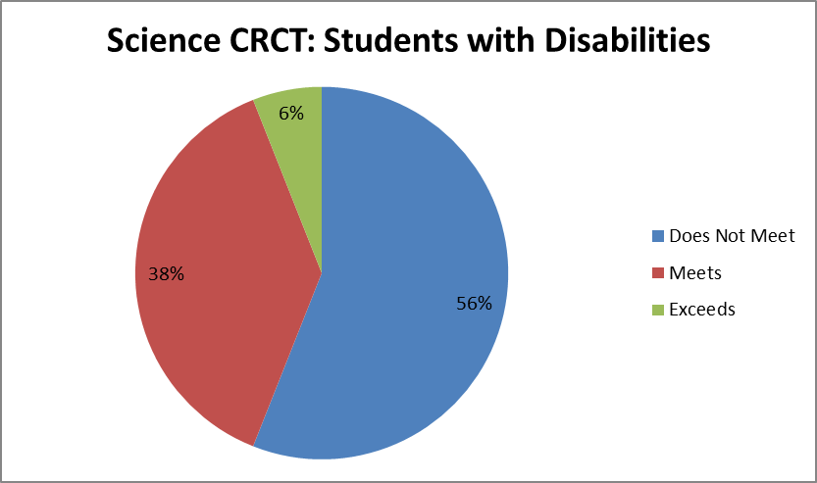
Looking Closer: 2012 Science
In 2012, 44% of Students with Disabilities Met or Exceeded the Standards on the Science CRCT
Data from Spring 2012

Slide 13
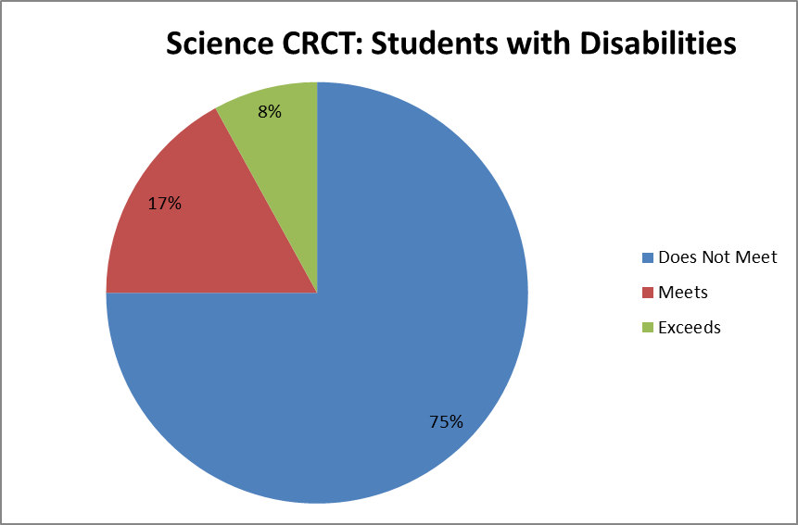
Closing the Gap
In 2012, 44% of Students with Disabilities Met or Exceeded the Standards on the Science CRCT
In 2011, 25% of Students with Disabilities Met or Exceeded the Standards on the Science CRCT
Data from Spring 2011

Slide 14
Summary
The number of Hollydale students meeting or exceeding the standards on CRCT falls below the district and state averages in all subject areas.
The number of students meeting or exceeding the standards in science is considerably less than all subject areas
Female students outperform male students
The number of Students with Disabilities meeting or exceeding the standards in science is increasing

Slide 15
Talk About It
We see that the percentage of Students with Disabilities meeting or exceeding the standards in Science is increasing. What can we do with other student populations to increase the percentage of proficient students?
English Language Learners?
Economically Disadvantaged?

