Slide 1
Capstone Presentation
Parent Resources Online (PRO)
Kirsten Allen and Maggie Phillips
Instructional Technology
Kennesaw State University

Slide 2
Agenda
Introduction
The Problem
Capstone Plan
Capstone Implementation
Evaluation Plan
Reflection
Copyright Acknowledgement

Slide 3
The Problem
Parents want to support their child’s learning, but are often at a loss as to the best way to do this.
Research confirms that parental involvement positively impacts student motivation, self-esteem, and behavior (National Parent Teacher Association).
Research suggests that the most effective type of parental involvement is that which engages parents in working with their children on learning experiences at home (Cotton & Wikelhund, 1989).

Slide 4
Capstone Plan
Compile parent and teacher feedback in order to create a plan for Parent Resources Online (PRO)
Use feedback to develop and implement a website designed to assist parents in facilitating learning experiences at home.
Website will include:
Information about the Common Core Curriculum
Reading resources
Math resources
Video tutorials

Slide 5
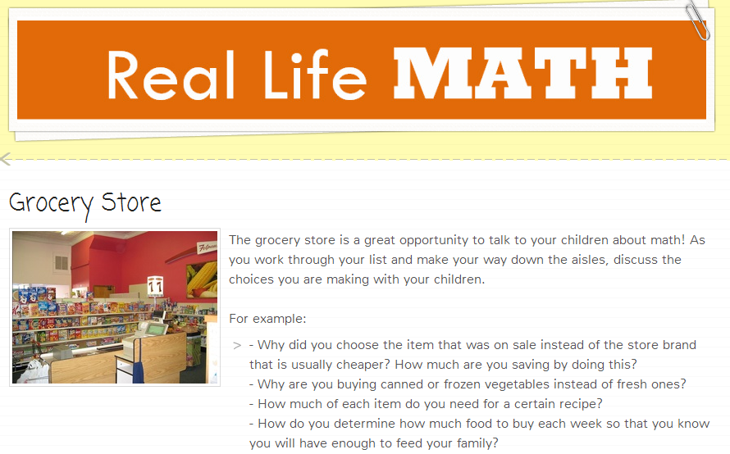
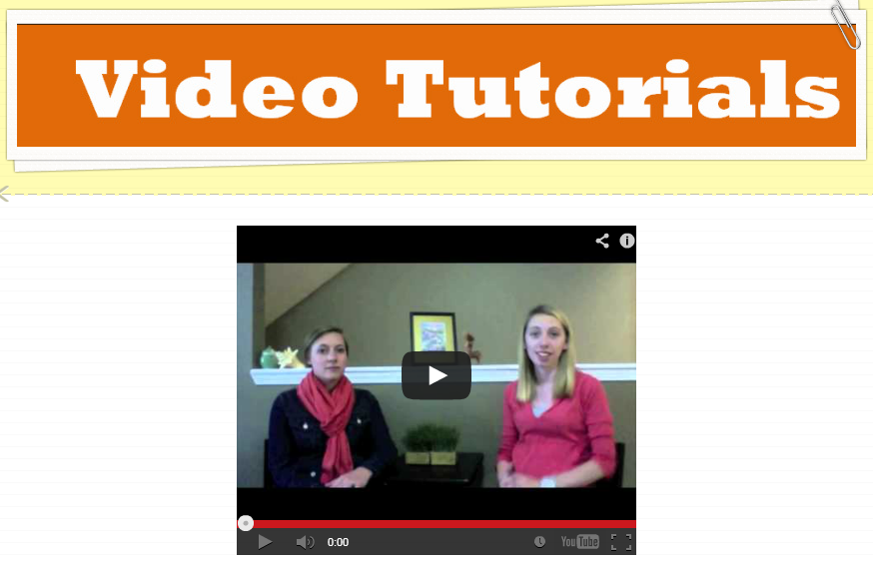
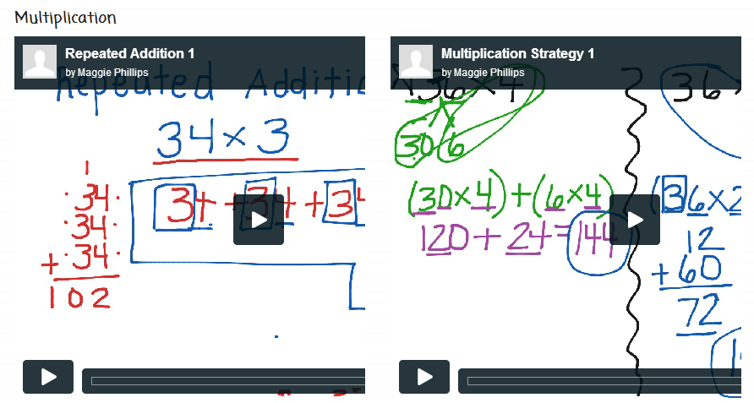
Description of Capstone
Math Resources
Standards
Video Tutorials
Games and Activities
Real Life Math

Slide 6
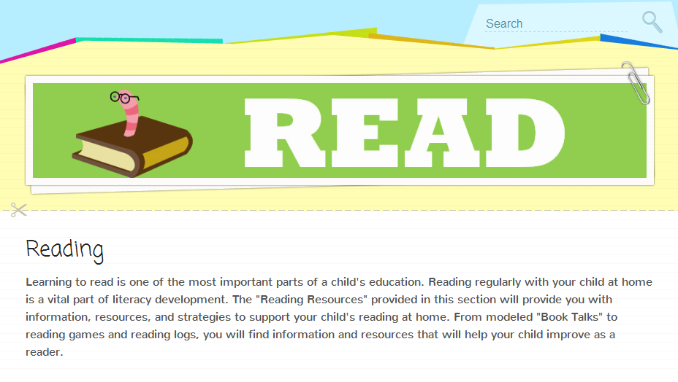
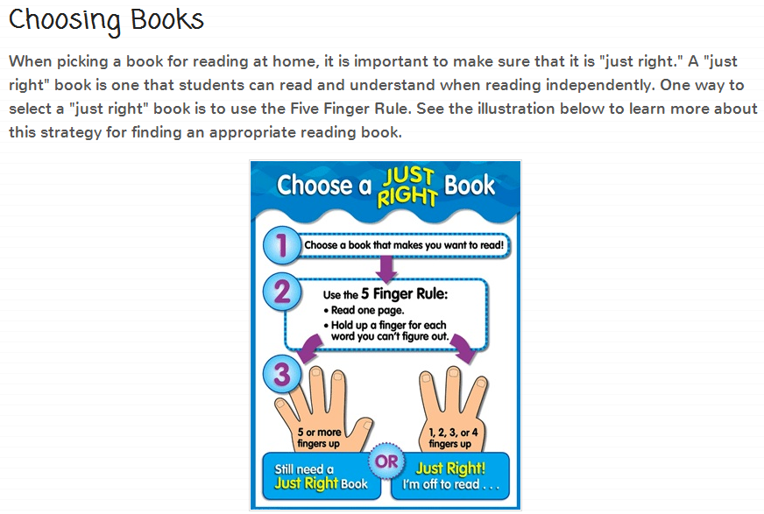
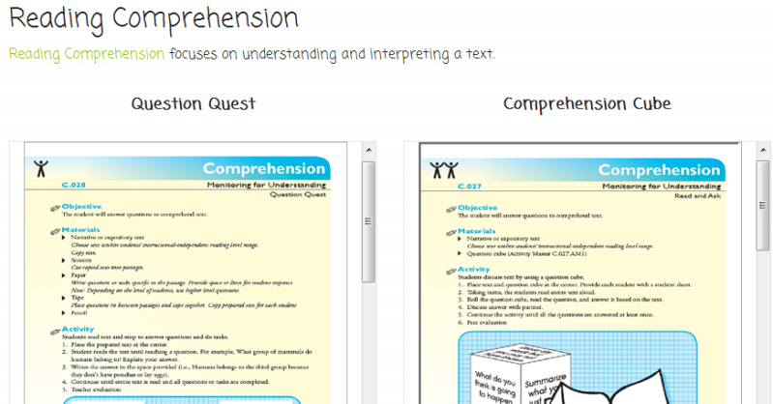
Description of Capstone
Reading Resources:
Video Tutorials
Resources for choosing books and understanding reading levels
Reading Activities

Slide 7
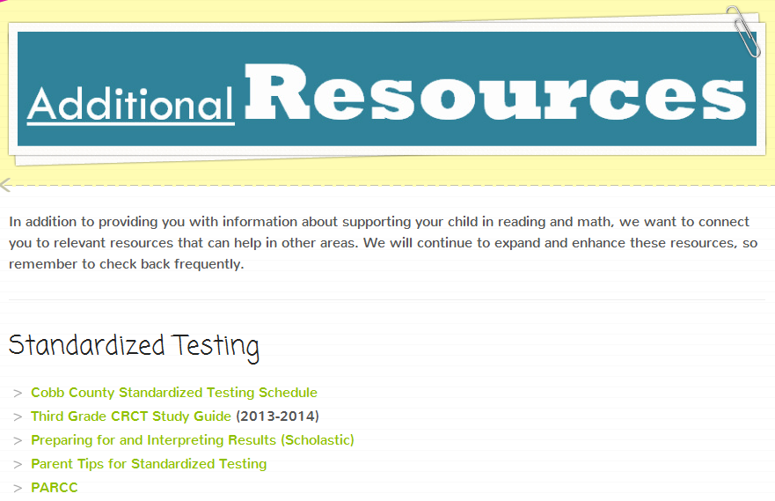
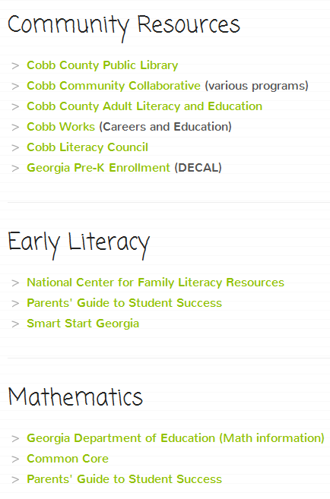
Description of Capstone
Additional Resources:
Standardized testing
Community Resources
Early Literacy
Mathematics

Slide 8
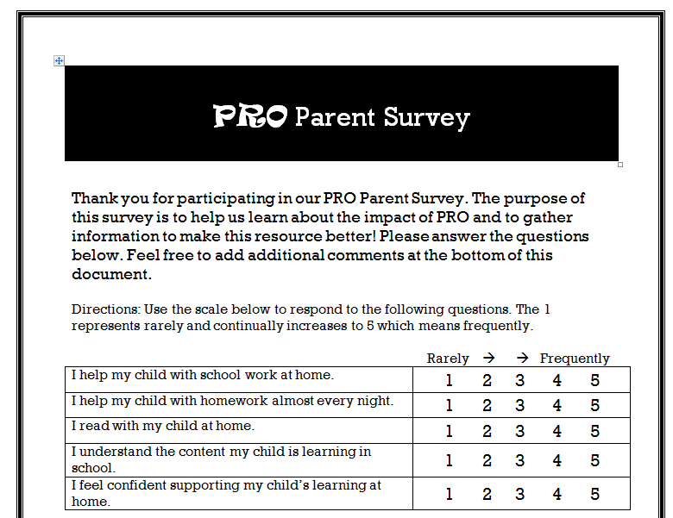
Evaluation Plan and Results
Evaluation:
Survey pre/post implementation
Focus groups with teachers and parents
Results:
Increase in parent understanding of content
Increase in parent confidence related to learning support
Increase in amount of time supporting learning at home

Slide 9
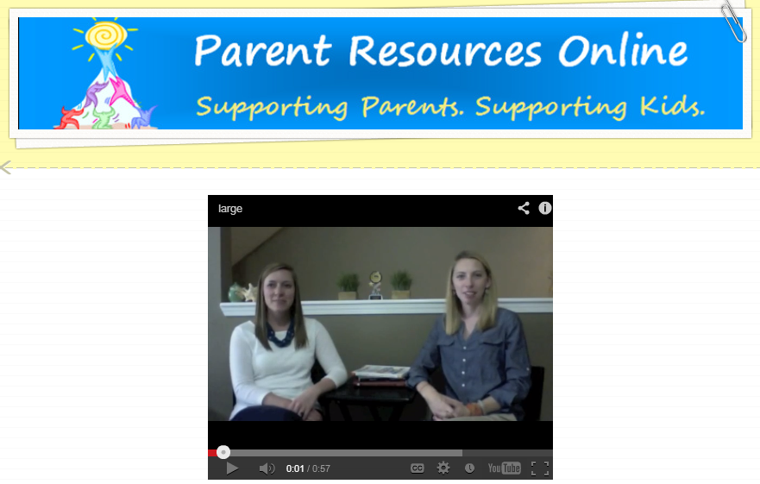
Reflections
Maggie: Continual evaluation and solicitation of feedback is a critical component of developing a user-friendly technology-based resource.
Kirsten: Many parents have the desire to help their student, however they do not know how. By providing resources, they are able to become more active participants in their child’s education. PRO provides a great place to start!

Slide 10
Copyright Acknowledgement
Cotton, K. & Wikelund, K. R. (1989), Parent involvement in education, School Improvement Research Series, Close-Up No. 6, Northwest Regional Educational Laboratory. www.nwrel.org/dcpd/sirs/3/cu6.html
Creek, B. (Photographer). (2004, May 18). Kids N Stuff - Albion [Print
Photo]. Retrieved from http://www.flickr.com/photos/battlecreekcvb/2984492110/
National Parent-Teacher Association. National standards for parent/family involvement programs. www.pta.org/programs/pfostand.htm#Success
Parcc college and career readiness for the next generation. (2013, February). Retrieved from http://www.parcconline.org/sites/parcc/files/PARCC-Overview-February2013.pdf

