Slide 1
In Education
Kirsten Allen
Wendy Goldberg
Maggie Phillips

Slide 2
What is Pinterest?
Pinterest is a social, photo sharing website that allows users to create and manage theme-based image collections.
Users can browse other pinboards for inspiration, 're-pin' images to their own collections or 'like' photos.
When you click on an image it takes you to the original source, with more ideas

Slide 3
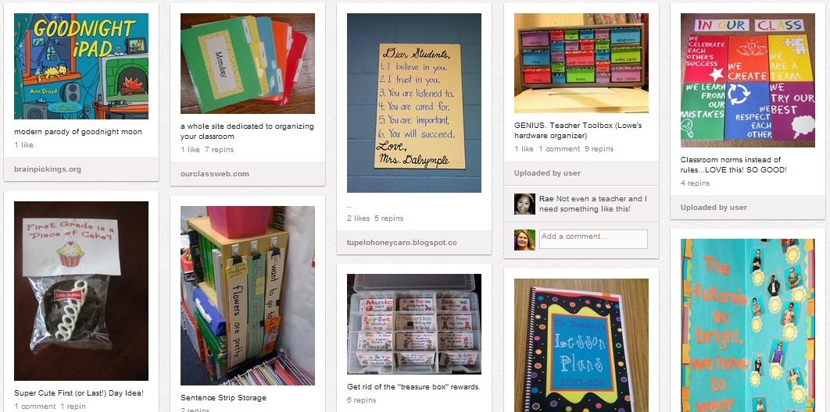

Slide 4
Purpose of Pinterest
The purpose of Pinterest is to "connect everyone in the world through the 'things' they find interesting via a global platform of inspiration and idea sharing.”
Turn and Talk: How might this be used purpose be reflected in education?

Slide 5
Pinterest in Education
Lesson Plans: Explore themed lessons or units or browse by standards (now or later usage)
Sharing Ideas: Facilitates global interaction through ideas and interests
Organization: Organizing a vast array of information for easy location in the future
Student Use: Creative resource for students to organize resources for projects and assignments; Facilitates student collaboration

Slide 6
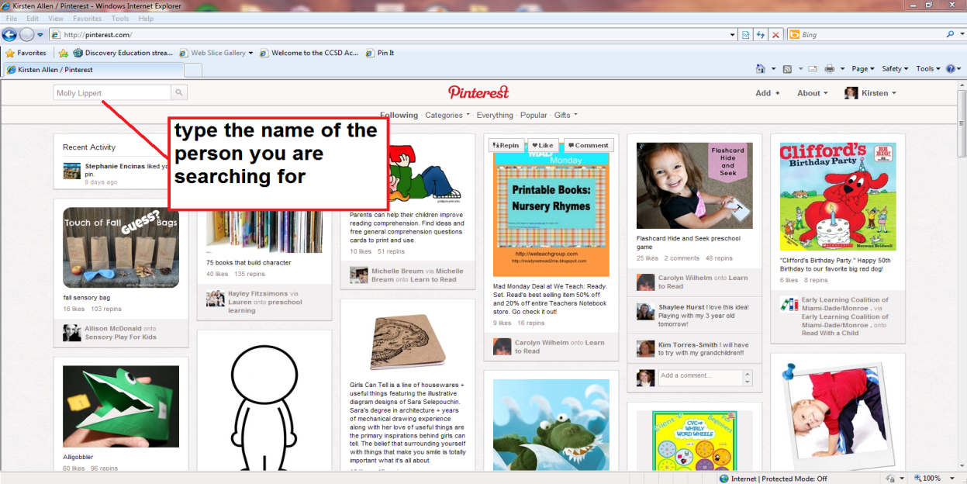
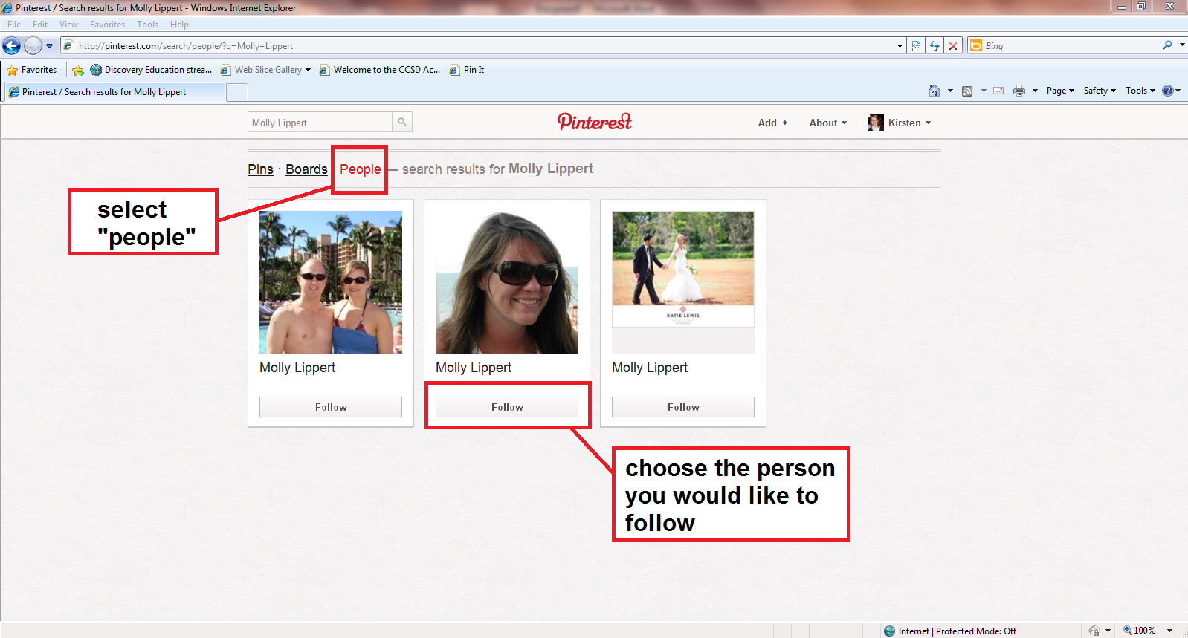
Following People
Use the Search box in the upper left corner to type in the name of the person you want to follow.
Once you find them, select which of their Boards you would like to follow.

Slide 7
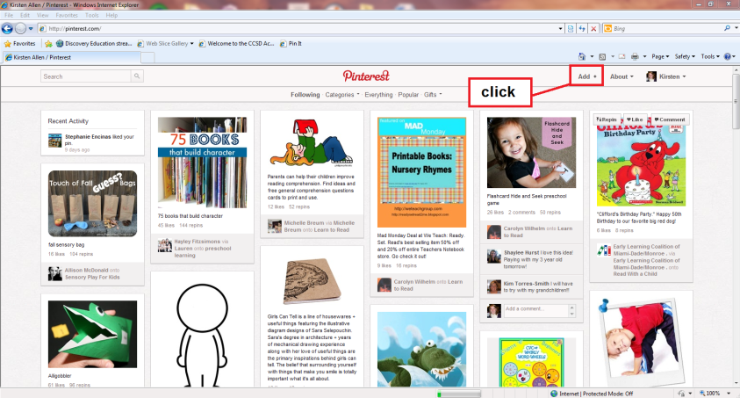
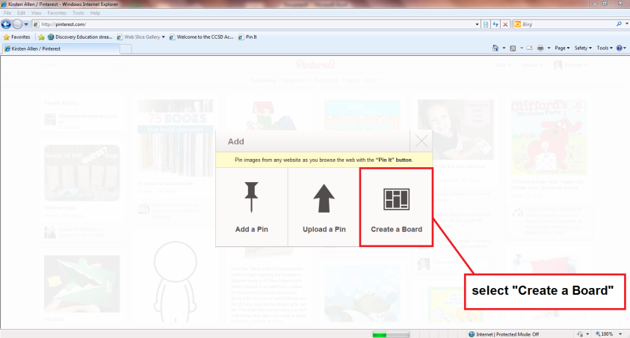
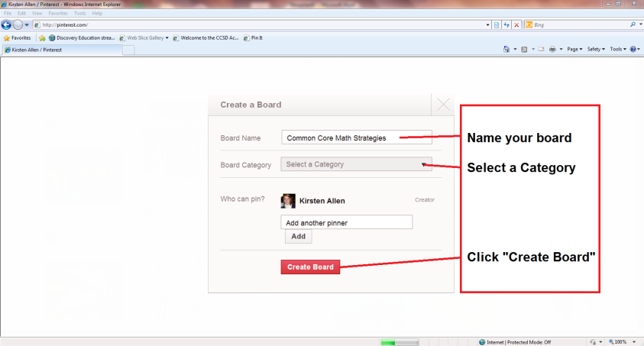
Creating Boards
Once you have established your account and are logged in, an icon will appear in the upper left corner of the screen that says Add+
Click Add+. Select Create a Board. Next, you will Name your board, and assign it a category.
When you are finished, Click the red icon Create Board

Slide 8
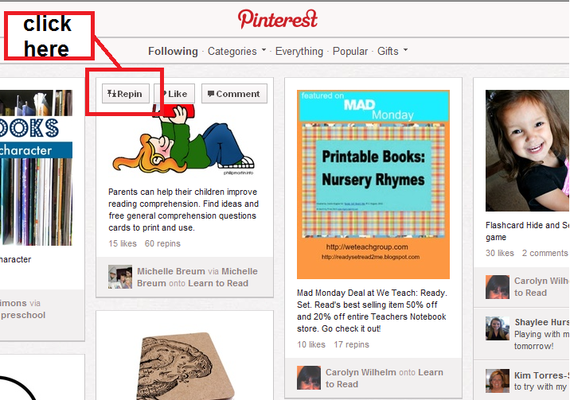
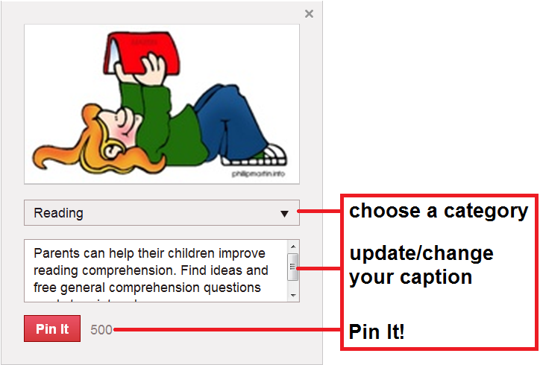
Re-Pinning Things
Browse Pins and select the one you would like to Repin.
Hover over the Pin, and in the upper, left corner, an icon (Repin) will appear.
After you have clicked Repin, some options will appear. Select the board you would like to Pin to and change the caption if you would like.
Finally, click the red button, Pin It at the bottom and your Pin will appear on your Board.

Slide 9
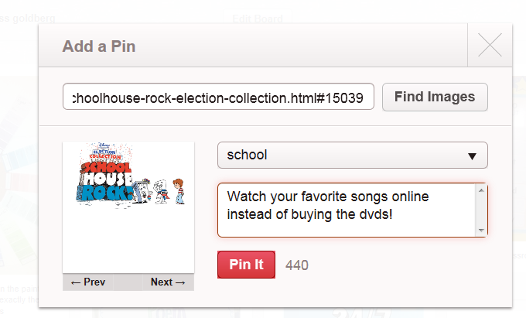
Pinning from the Internet
1. Choose “add +” on the top right.
2. Choose “add a pin”.
3. Enter in the URL of the site you wish to pin.
4. Choose “find images” to represent your pin. Pinterest will automatically choose your image.
5. After you have your image, choose your board and write a description.
6. Pin It! ☺

Slide 10
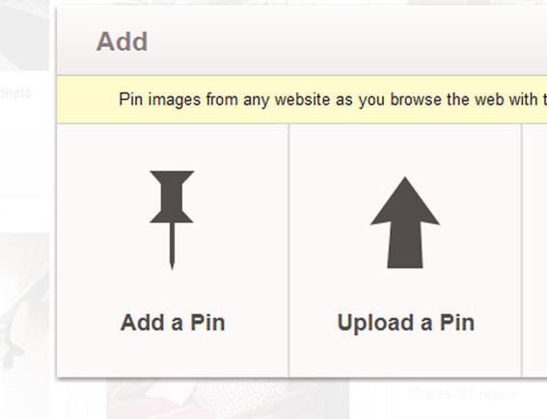
Pinning from Files
To pin from your own files…
1. Choose “upload a pin.”
2. Select the file you wish to pin.
3. Follow steps 4-6 for pinning from the internet.

Slide 11
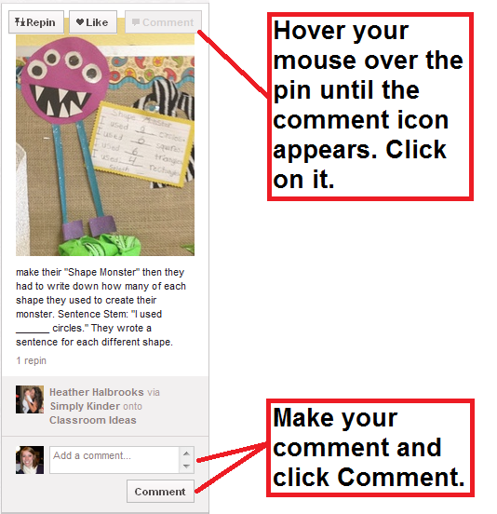
Commenting for Collaboration
They say a picture can say 1,000 words, but sometimes it can’t.
Describe your original pins, or change someone else’s descriptions for a brief explanation of what you like about your pin and/or how you use your pin.
Take advantage of the comment section. It is a great area to continue collaboration.

Slide 12
Putting Pins to Use
Remember, everything you pin can and probably will be changed to meet the needs of your kids. Here are a few examples of pins coming to life in a classroom!

Slide 13
